Slide 1


Multi Class Animal Classification
Name : Ayush K Tammannavar
AICTE Student ID : STU679af5085b1861738208520

Slide 2

Learning Objectives
During my internship on multi-class animal classification, I learned :
Building CNN Models: I learnt how to design and train Convolutional Neural Networks for image classification.
Working with MobileNetV2: I explored transfer learning using MobileNetV2 and understood how to fine-tune it for better results.
Training on a 90-Class Dataset: I gained hands-on experience training and validating models on a dataset with 90 animal categories.
Model Evaluation & Tuning:
I explored various metrics and tuning methods to improve model accuracy and performance.
Understanding Real-World AI Challenges: I developed a practical understanding of issues like class imbalance, generalization, and deployment concerns.
GOAL
Source :
www.freepik.com/

Slide 3
Tools and Technology used
Programing language used : Python
Frameworks used : Tensorflow , Keras , Flask
Pre-trained model : MobileNetV2
Environment : Google colab , Jupyter notebook
Dataset : Animal Image Dataset (90 Different Animals) – Sourav Banerjee (https://www.kaggle.com/datasets/iamsouravbanerjee/animal-image-dataset-90-different-animals?resource=download)
Tools : Numpy , Matplotlib , Seaborn , Kagglehub

Slide 4
Methodology
Data Collection: Downloaded a dataset of 90 different animal classes using kagglehub
Data Processing: Preprocessed the images using ImageDataGenerator with resizing, rescaling, and validation split.
Model Selection: Chose MobileNetV2 as the base model for its lightweight and efficient performance on image tasks.
Training the Model: Trained the model using the processed dataset with categorical cross-entropy loss and Adam optimizer.
Model Evaluation: Assessed model performance using validation data and printed classification metrics.
Testing the Model: Validated the trained model on unseen data to check real-world performance.
Interface Development: Built a Flask web interface to allow users to upload animal images and get predictions.

Slide 5
Problem Statement:
In the real world, wildlife conservationists, researchers, and environmental organizations often face challenges in quickly and accurately identifying animal species from camera trap images, especially in remote or biodiversity-rich regions. Manual classification is time-consuming, prone to human error, and not scalable for large datasets. There is a need for an efficient, automated solution that can classify a wide range of animal species with high accuracy to support conservation efforts, biodiversity monitoring, and ecological studies.
This project aims to develop a deep learning-based image classification system using Convolutional Neural Networks (CNNs) and MobileNetV2 to accurately identify animals from a dataset of 90 different species. The model is integrated into a user-friendly Flask web application, making it accessible and practical for real-world deployment in wildlife monitoring and educational tools.

Slide 6
Solution:
To tackle the challenge of identifying multiple animal species efficiently, I developed a deep learning-based image classification system. The process began with collecting and preprocessing a dataset containing 90 different animal classes. I used transfer learning by fine-tuning the MobileNetV2 model, chosen for its lightweight structure and strong performance on image tasks.
For multi-class classification, I used a Softmax activation function in the output layer to generate accurate class probabilities. Interestingly, the model performed exceptionally well even without applying additional regularization techniques, which highlights the effectiveness of the data quality and the base model.
After training, validating, and testing the model to ensure consistent performance, I built a simple and intuitive web interface using Flask. This allows users to upload animal images and receive instant predictions. The result is a practical and scalable solution that can support wildlife monitoring, conservation efforts, and educational tools.

Slide 7
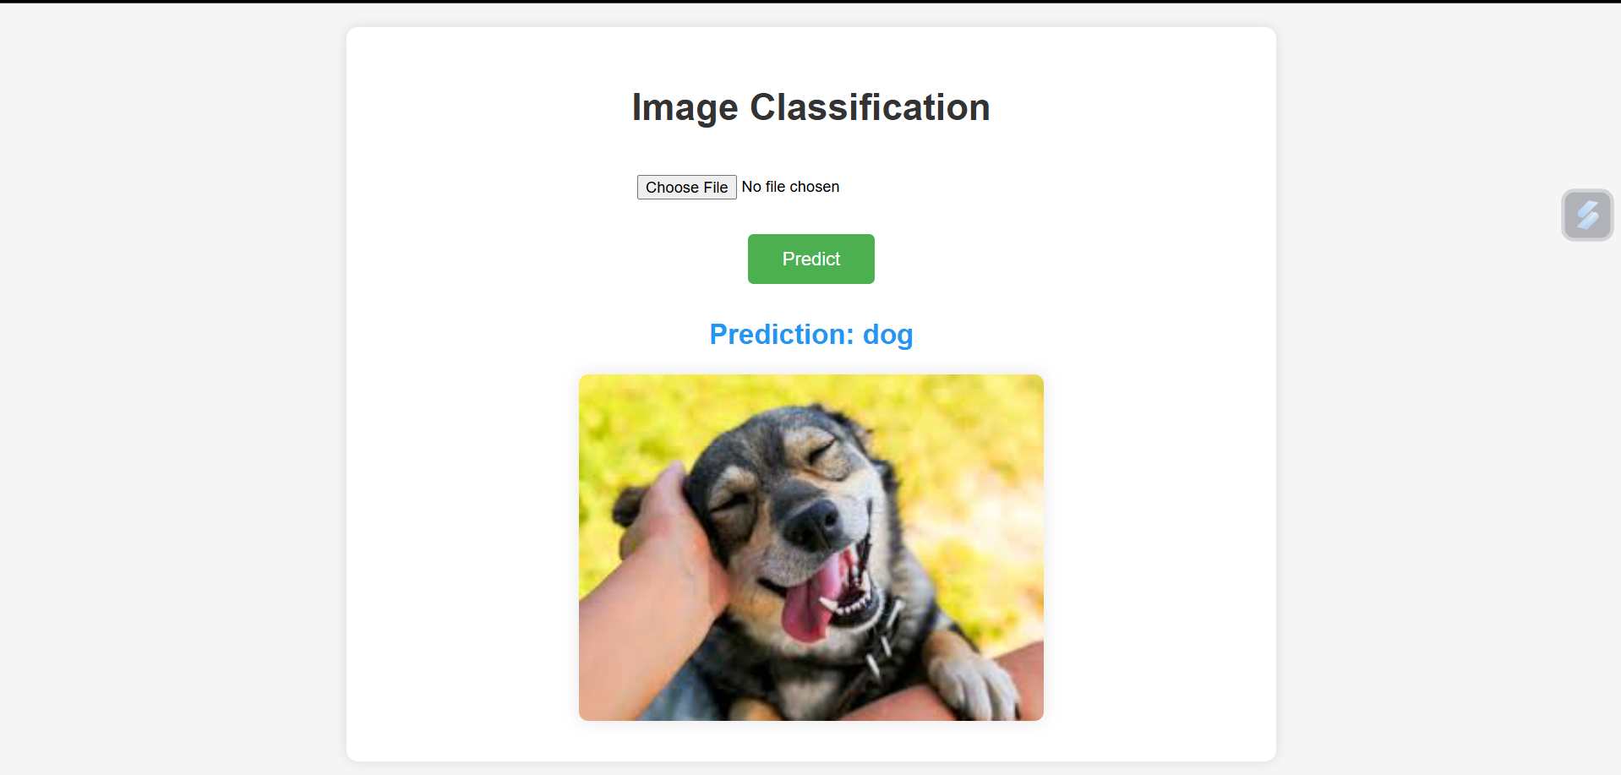
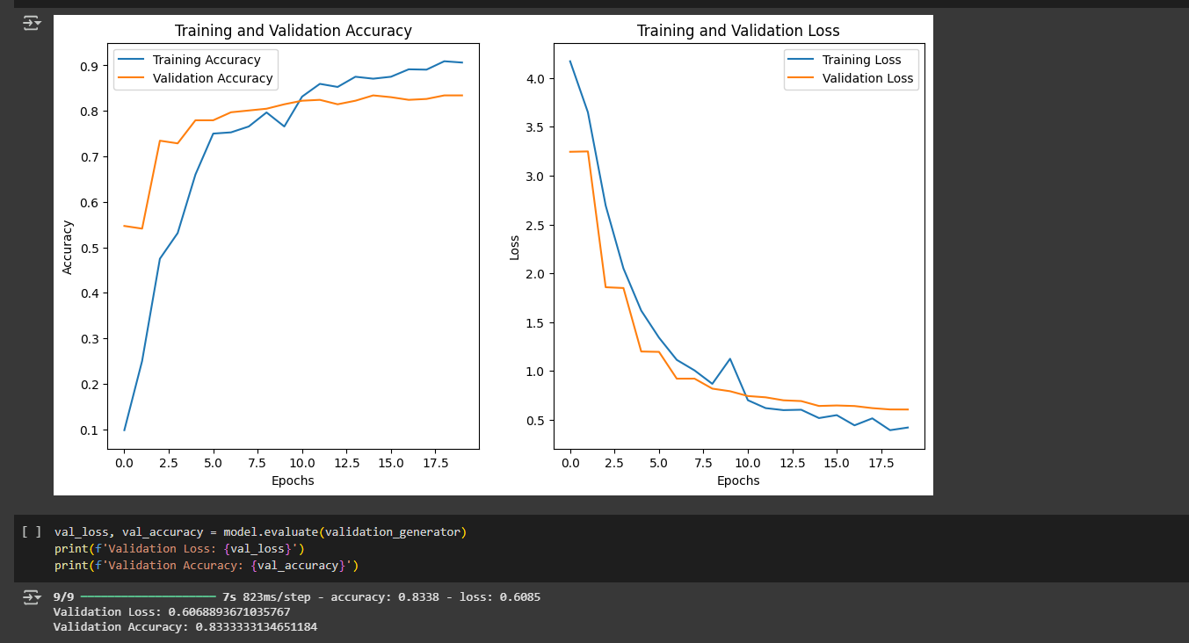
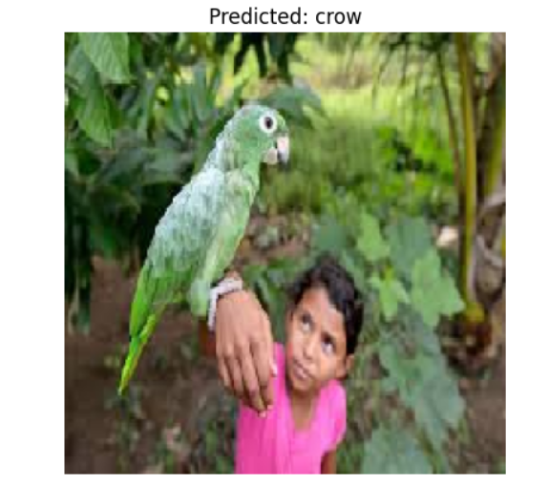
Screenshot of Output:
Github Repository link :

Slide 8
Conclusion:
In this study, we implemented an image classification model using MobileNetV2, achieving a test accuracy of 90% and a validation accuracy of 83%. These results indicate that the model has strong potential for high-level classification and is lightweight enough to be used in real-time detection systems.
However, some misclassifications were observed, primarily due to the low quality of input images, which affected the model's ability to make accurate predictions. This highlights the importance of high-quality, well-preprocessed data for optimal performance in real-world scenarios.
To further improve accuracy and reliability, future work will focus on:
Enhancing image quality through better data preprocessing and augmentation,
Fine-tuning the model with a more diverse dataset,
And potentially incorporating techniques like attention mechanisms or model ensembles.
With these improvements, the model can be made more robust and ready for deployment in practical, real-time AI systems.

